Slide 1


Game of Phones System Inception
D³

Slide 2
What are we building?

Slide 3
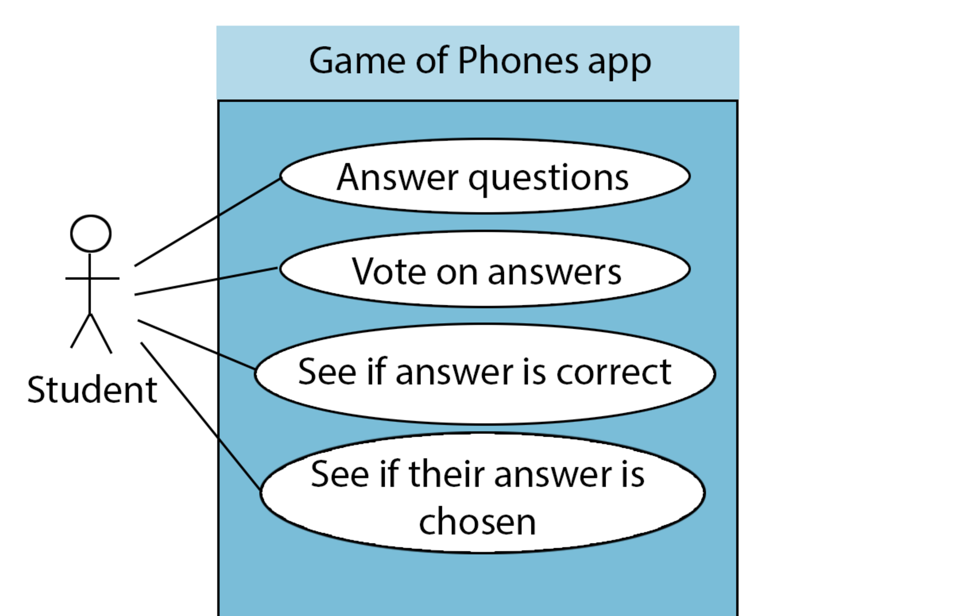

Slide 4
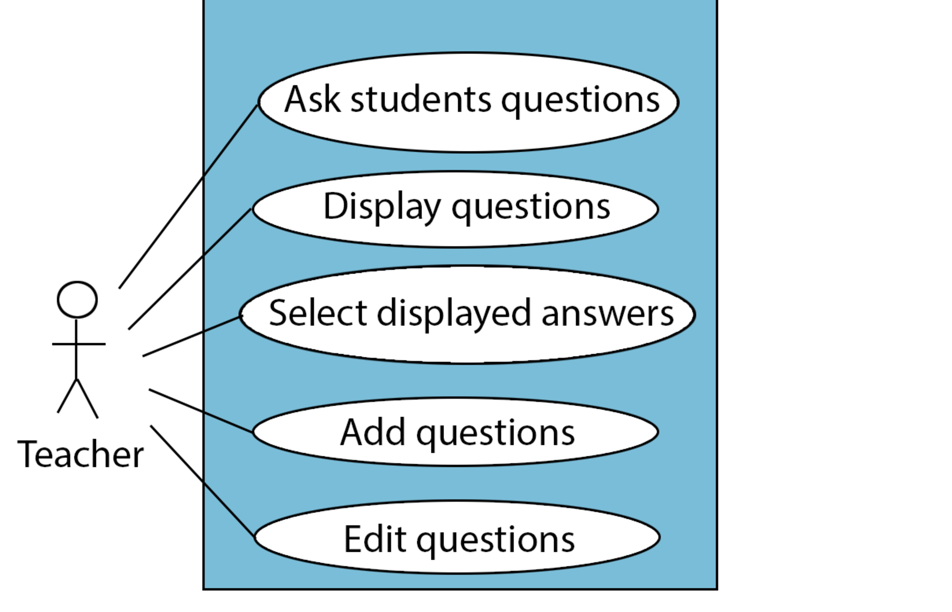

Slide 5
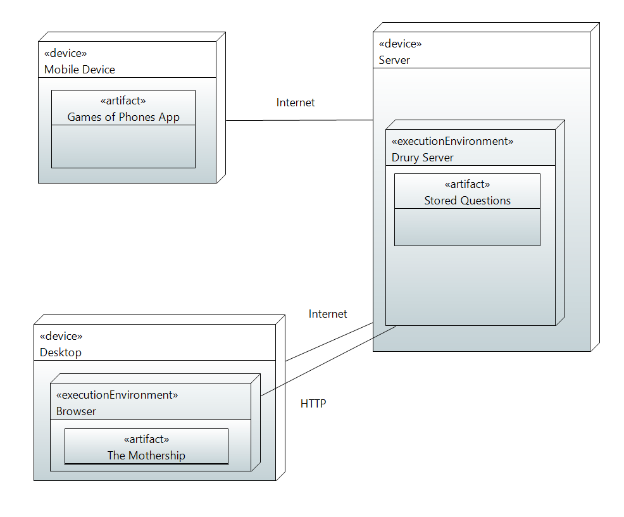
Phone App Technologies
o iOS (none)
o Android (Tutorial)
Application and Web Development
o Java (Moderate)
o Swift (None)
o HTML 5 (Moderate)
o JavaScript (Small Scale)
o JQuery (Small Scale)
o Bootstrap (Small Scale)
Web Server Scripting
o PHP (Small Scale)
o Microsoft ASP .NET (None)

Slide 6
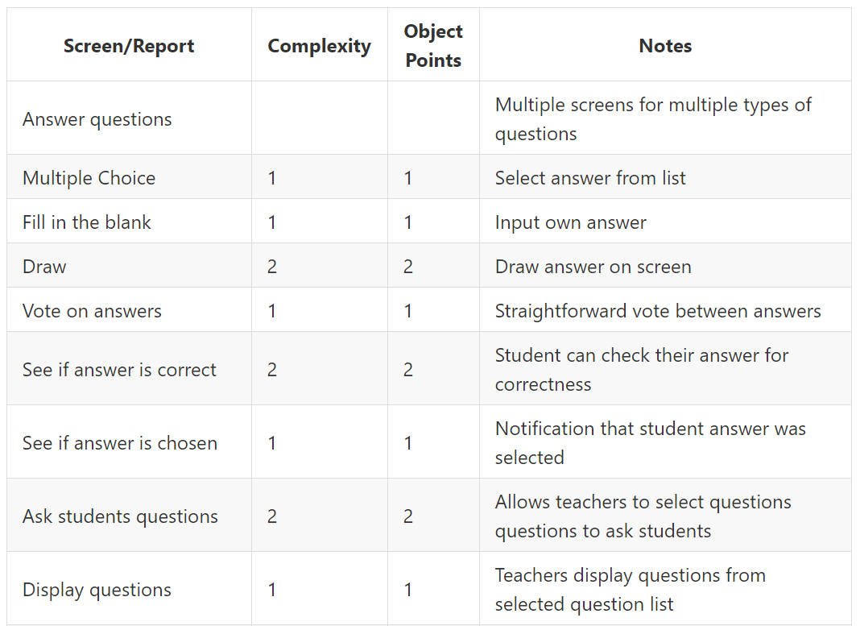
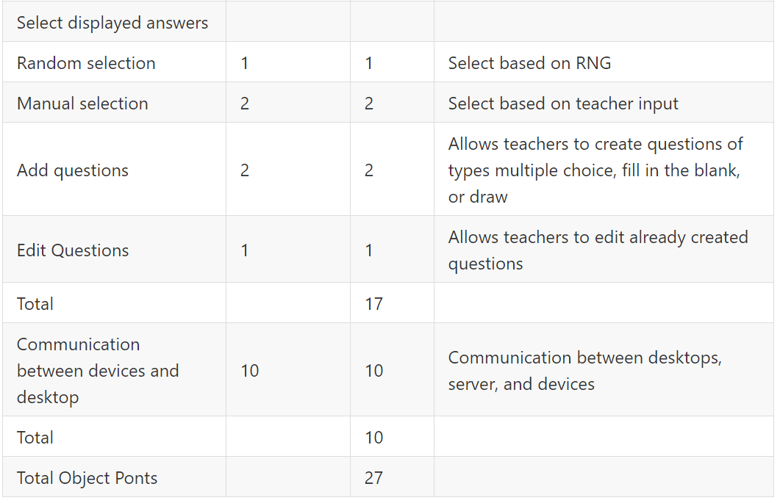
Total of 5 person months
Total of 4.25 complete months for a 4.3 person team

Slide 7
Plan for sprint 1
Biggest risk: Connectivity
Smallest usable functionality: Asking 1 question, receiving an answer

Slide 8
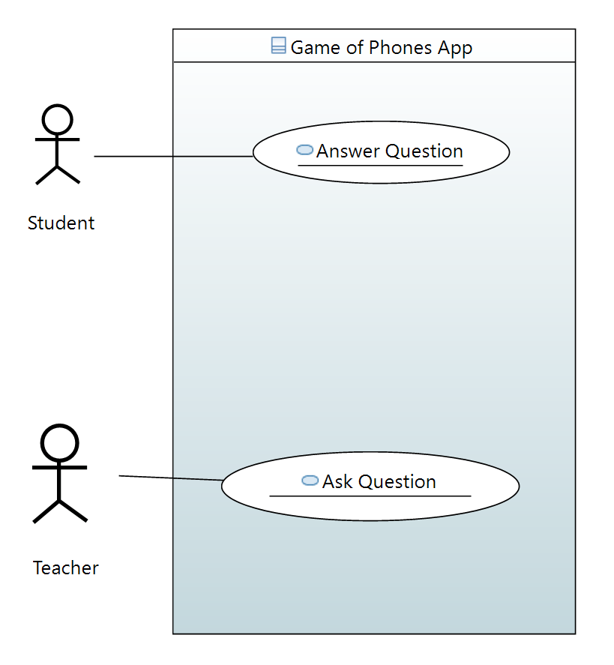

Slide 9
Questions?

